Slide 1


INSTITUTE FOR ADVANCED COMPUTING AND SOFTWARE DEVELOPMENT AKURDI, PUNE Implementing CI/CD Pipeline using Nexus and Deploying the Artifact to Apache Tomcat
GROUP NO: 11
Kapil Nanden (233421)
Sajid Shaikh (233441)
Mr. Kartik Awari Mr. Rohit Puranik
PROJECT GUIDE CENTRE CO-ORDINATOR

Slide 2

INTRODUCTION
Welcome to our presentation on implementing a CI/CD pipeline using Nexus and deploying the artifact to Apache Tomcat.
In today's fast-paced world, delivering quality software quickly is of utmost importance. This is where Continuous Integration and Continuous Deployment (CI/CD) comes in. By automating the build, test, and deployment process, we can ensure that our software is always up-to-date and working as intended. And that's exactly what we'll be discussing today.

Slide 3
What is CI/CD?
CI/CD stands for Continuous Integration/Continuous Deployment, which is a software development practice that aims to increase efficiency and quality by automating the process of building, testing, and deploying code changes.
CI/CD helps developers catch bugs and errors early in the development cycle, which saves time and resources. It also allows for faster and more frequent deployments, which means that new features and updates can be released to users more quickly.
In short, CI/CD is essential for modern software development because it streamlines the development process, improves quality, and speeds up deployment times.

Slide 4

Setting Up Jenkins with GitHub
To set up Jenkins with GitHub, first, you need to install and configure the GitHub plugin in Jenkins. This plugin allows Jenkins to authenticate with GitHub and access your repositories. Once the plugin is installed, you can create a new Jenkins job and configure it to build from your GitHub repository.
Next, you can set up a webhook in GitHub that triggers a build in Jenkins whenever changes are pushed to the repository. This allows for automatic builds and deployments, saving time and effort in the development process.

Slide 5

Using Maven for Build Automation
Maven is a powerful build automation tool that can be integrated into a Jenkins CI/CD Pipeline to streamline the build process and improve efficiency. With Maven, developers can easily manage project dependencies, automate the build process, and generate reports on code quality.
One of the key benefits of using Maven in a Jenkins CI/CD Pipeline is that it simplifies the build process. Instead of manually managing dependencies and configuring build settings, developers can simply define the project structure and let Maven handle the rest. This not only saves time but also reduces the risk of errors and inconsistencies in the build process.

Slide 6
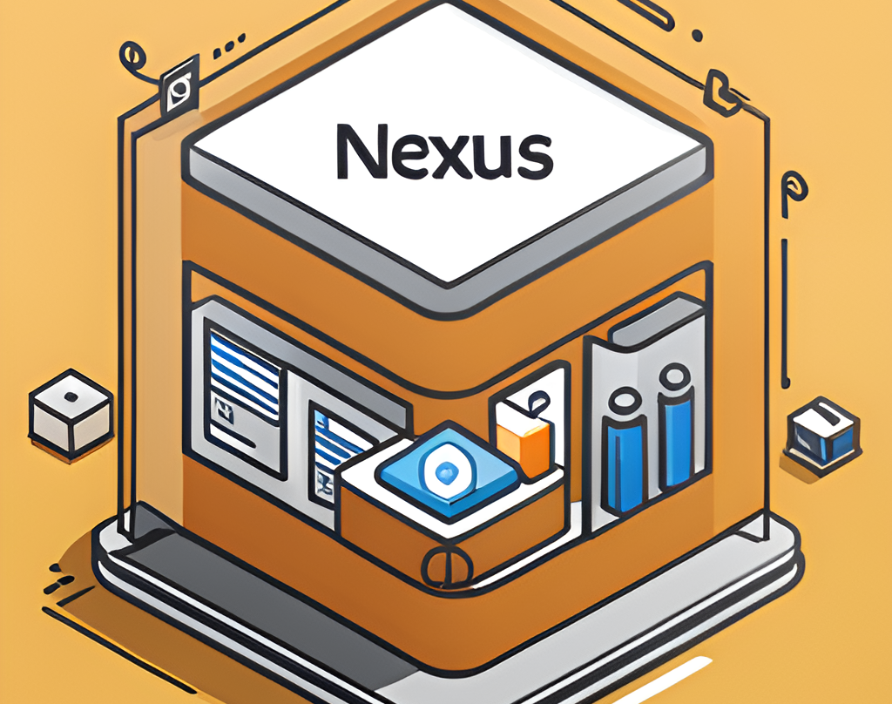
Nexus Overview
Nexus is a repository manager used for storing and managing software components. It plays a crucial role in the CI/CD pipeline by providing a central location for all the artifacts that are generated during the build process.
Nexus allows for easy sharing of artifacts between teams and ensures that there is a single source of truth for all the components. It also provides features like access control, versioning, and dependency management to ensure that the right components are used in the right place.

Slide 7

Integrating Nexus for Artifact Management
Nexus is a powerful tool that can be integrated into a Jenkins CI/CD Pipeline for artifact management. It allows organizations to store and manage their software artifacts in a central repository, making it easier to share code across teams and projects.
One of the main benefits of using Nexus is that it provides a single source of truth for all your artifacts. This means that everyone on your team is working with the same version of the code, which can help to prevent conflicts and ensure consistency. Additionally, Nexus makes it easy to search for and retrieve artifacts, which can save developers time and reduce errors.

Slide 8

Using SonarQube for Code Analysis
Code analysis is a crucial step in any software development process. It helps to identify potential issues early on and ensures that the code is maintainable and scalable. In a Jenkins CI/CD Pipeline, SonarQube can be used to achieve this. SonarQube is an open-source platform for continuous code quality inspection that provides detailed reports on code quality, security, and maintainability.
SonarQube uses a set of rules to analyze code and provide feedback on issues such as code smells, bugs, and vulnerabilities. It also provides suggestions on how to fix these issues. For example, it can flag unused variables, poorly formatted code, or even security vulnerabilities. By using SonarQube in a Jenkins CI/CD Pipeline, developers can ensure that their code is of high quality and free from potential issues before it is deployed.

Slide 9

Deploying to Tomcat
To deploy the application to Tomcat using Jenkins CI/CD Pipeline, follow these steps:
1. Set up a Tomcat server in Jenkins and configure it with the necessary credentials.
2. Create a new job in Jenkins and configure it to build and package the application using Maven.
3. Add a post-build action to deploy the packaged application to the Tomcat server.
4. Configure the deployment settings as per your requirements and save the changes.
5. Run the Jenkins job to deploy the application to Tomcat.

Slide 10
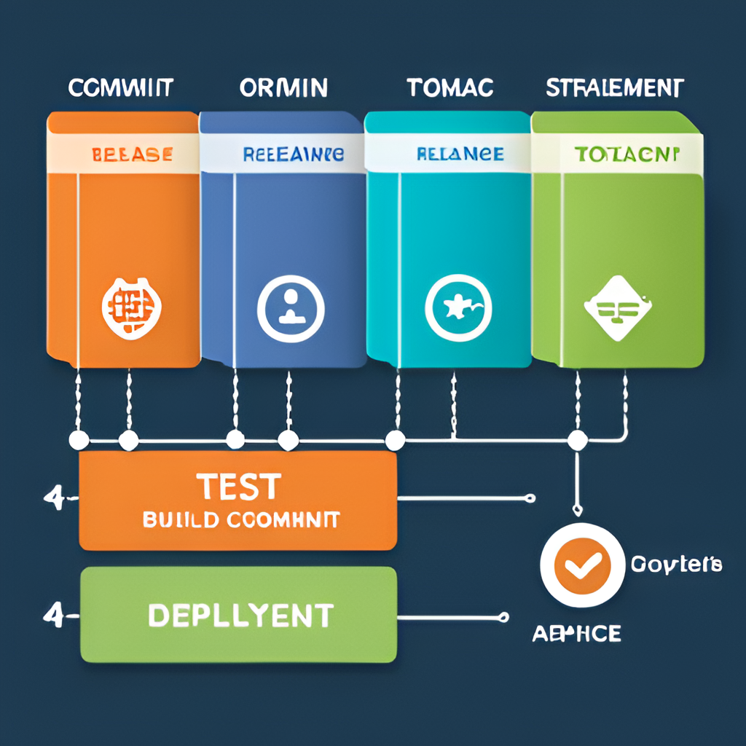
Conclusion
In conclusion, we have learned about the importance of implementing a CI/CD pipeline using Nexus and deploying the artifact to Apache Tomcat. This process allows for faster and more efficient software development, as well as improved collaboration between teams.
By utilizing Nexus, we can easily manage our dependencies and ensure that our builds are consistent and reliable. And by deploying to Apache Tomcat, we can quickly and easily make our applications available to our users.
We encourage you to implement these practices in your own work to improve your software development process and ultimately deliver better products to your customers.

Slide 11
THANK YOU

